Slide 1
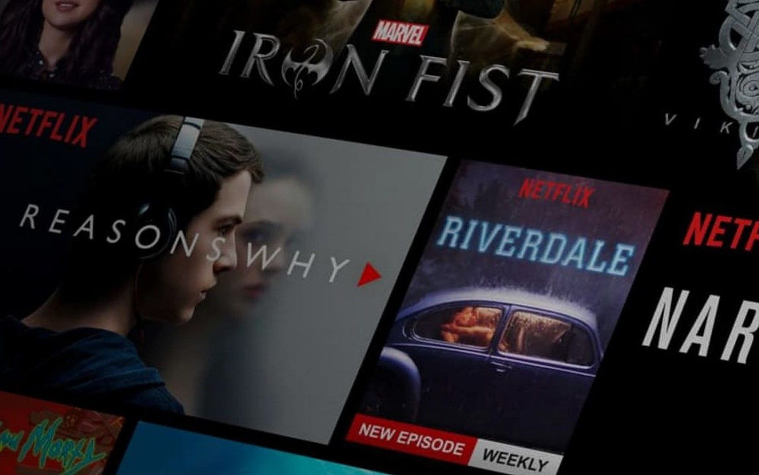
MOVIE
RECOMMENDATION
SYSTEM

Slide 2
CONTENT
1
Introduction to Movie Recommendation System
2
Overview of the Project
3
Data Collection and Preprocessing
4
Data Modelling and Analysis
5
Building Recommendation System Using Pycharm
6
Implementing Streamlit Interface
7
Results
8
Learnings
9
References

Slide 3
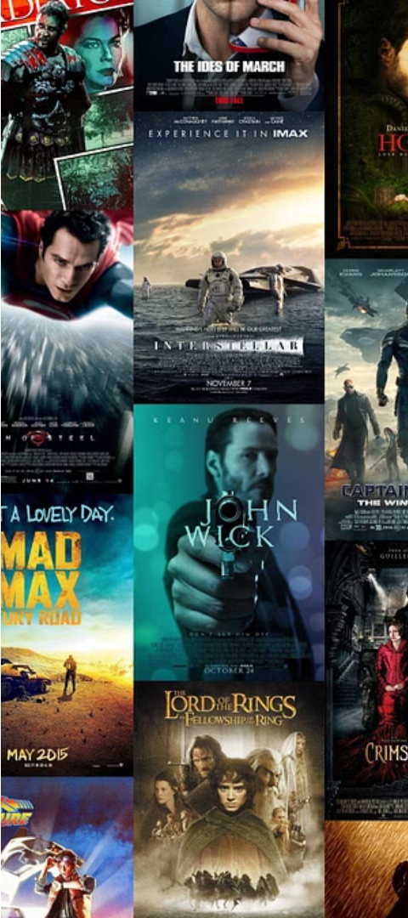
Introduction to Movie Recommendation Systems
Movie recommendation systems are powerful tools that analyze user preferences and suggest films they are likely to enjoy. These systems leverage data mining and machine learning techniques to understand user tastes and make personalized recommendations.

Slide 4
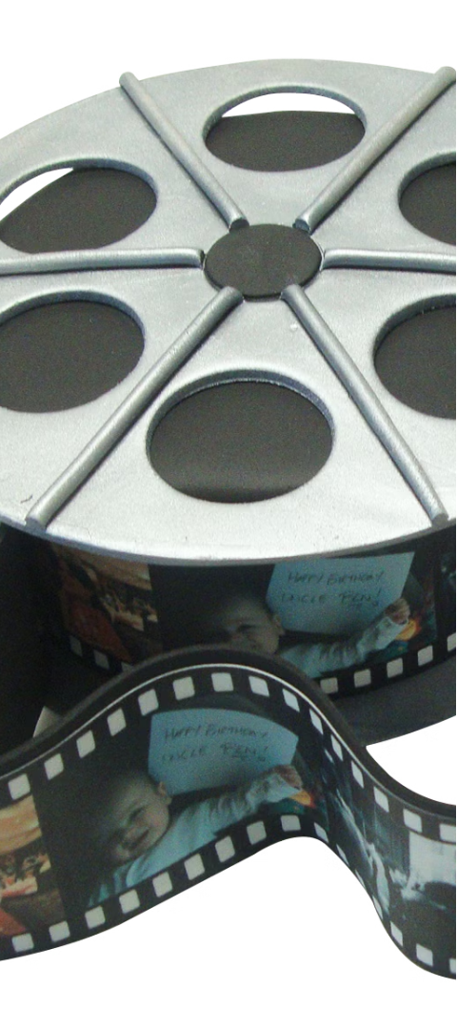
Overview of the Project
1
Data Collection
2
Data Preprocessing
Gathering genres, cast, keywords , crew metadata on a large set of movies to build a comprehensive database.
Cleaning and structuring the data to prepare it for modeling and analysis.
3
Modeling and Analysis
Applying machine learning algorithms to identify patterns and extract insights from the movie data.

Slide 5
Data Collection and Preprocessing in Jupyter Notebook
Data Collection
Data Cleaning
Feature Engineering
Leveraging APIs and web scraping techniques to gather movie data from various online sources.
Handling missing values, removing duplicates, and standardizing data formats using Pandas in Jupyter Notebook.
Creating new data features from the raw data to enhance the modeling process.

Slide 6
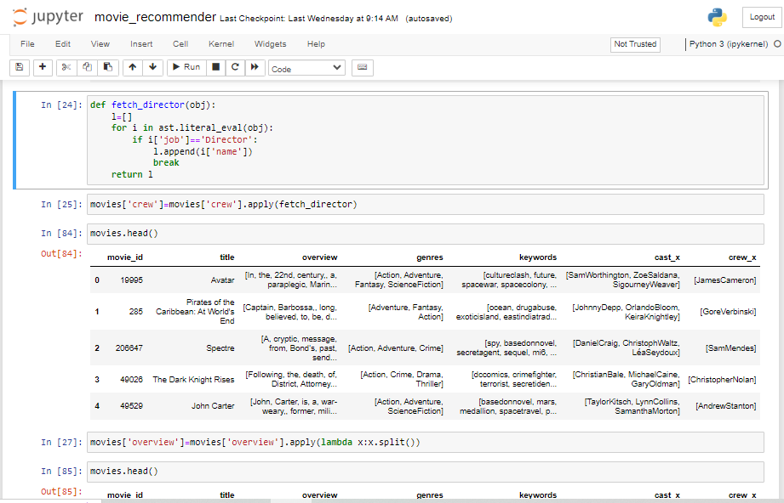
Data Modeling and Analysis in Jupyter Notebook
1
Exploratory Data Analysis
Conducting in-depth analysis to understand the characteristics and patterns in the movie dataset.
2
Model Selection
Evaluating and selecting the most appropriate machine learning algorithms for the recommendation task.
3
Model Training and Tuning
Iteratively training and optimizing the selected models to improve their recommendation accuracy.

Slide 7
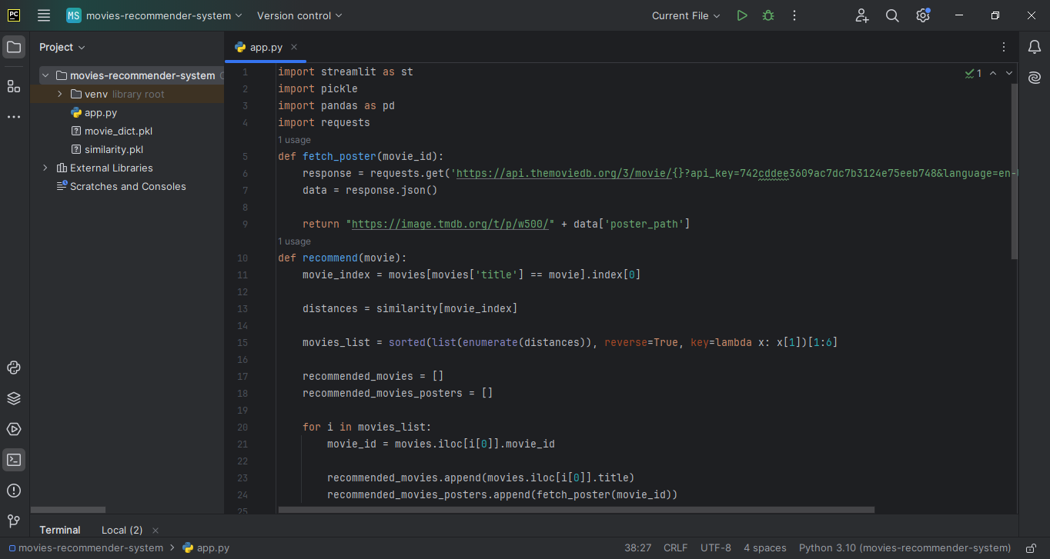
Building the Recommendation System using PyCharm
Integrating Models
Integrating the trained machine learning models into a cohesive recommendation system.
Enhancing User Experience
Developing a user-friendly interface to present the movie recommendations to end-users.

Slide 8

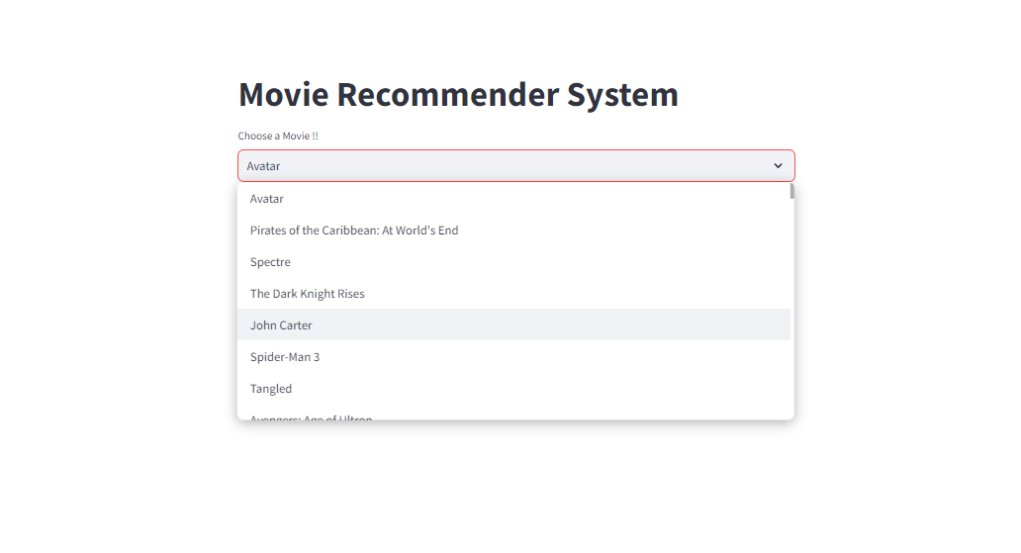

Implementing the Streamlit Interface
Search
Allow users to search for movies and receive personalized recommendations.
Filtering
Filtering recommendations based on genre, cast, crew, overview and other criteria.

Slide 9
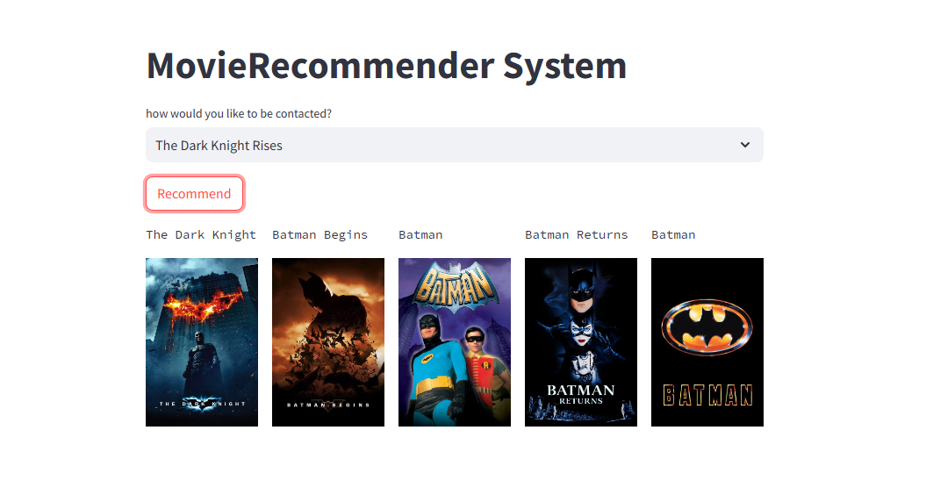


RESULTS
Personalized Recommendations
The system provides a list of movie recommendations tailored to each user's preferences.
Improved User Satisfaction
The recommendation system helps users discover new movies they are likely to enjoy, enhancing their overall movie-watching experience.

Slide 10
Learnings
Data Collection and Preprocessing
Importance of thorough data cleaning and feature engineering to prepare the dataset for modeling.
Model Selection and Tuning
Understanding the trade-offs between different machine learning algorithms and the need for iterative model optimization.
User Interface Design
Designing an intuitive and engaging user interface to present the movie recommendations effectively.
Deployment and Scalability
Considerations for deploying the recommendation system to a production environment and ensuring it can handle growing user demand.

Slide 11
REFERENCES
1
Tmdb.com
2
Streamlit.io
3
Pandas.Pydata.org
4
YouTube

Slide 12
THANK YOU!
ANY QUESTIONS?

